Slide 1
Assignment 3
Weiming Wen, Mingyang Zhou

Slide 2
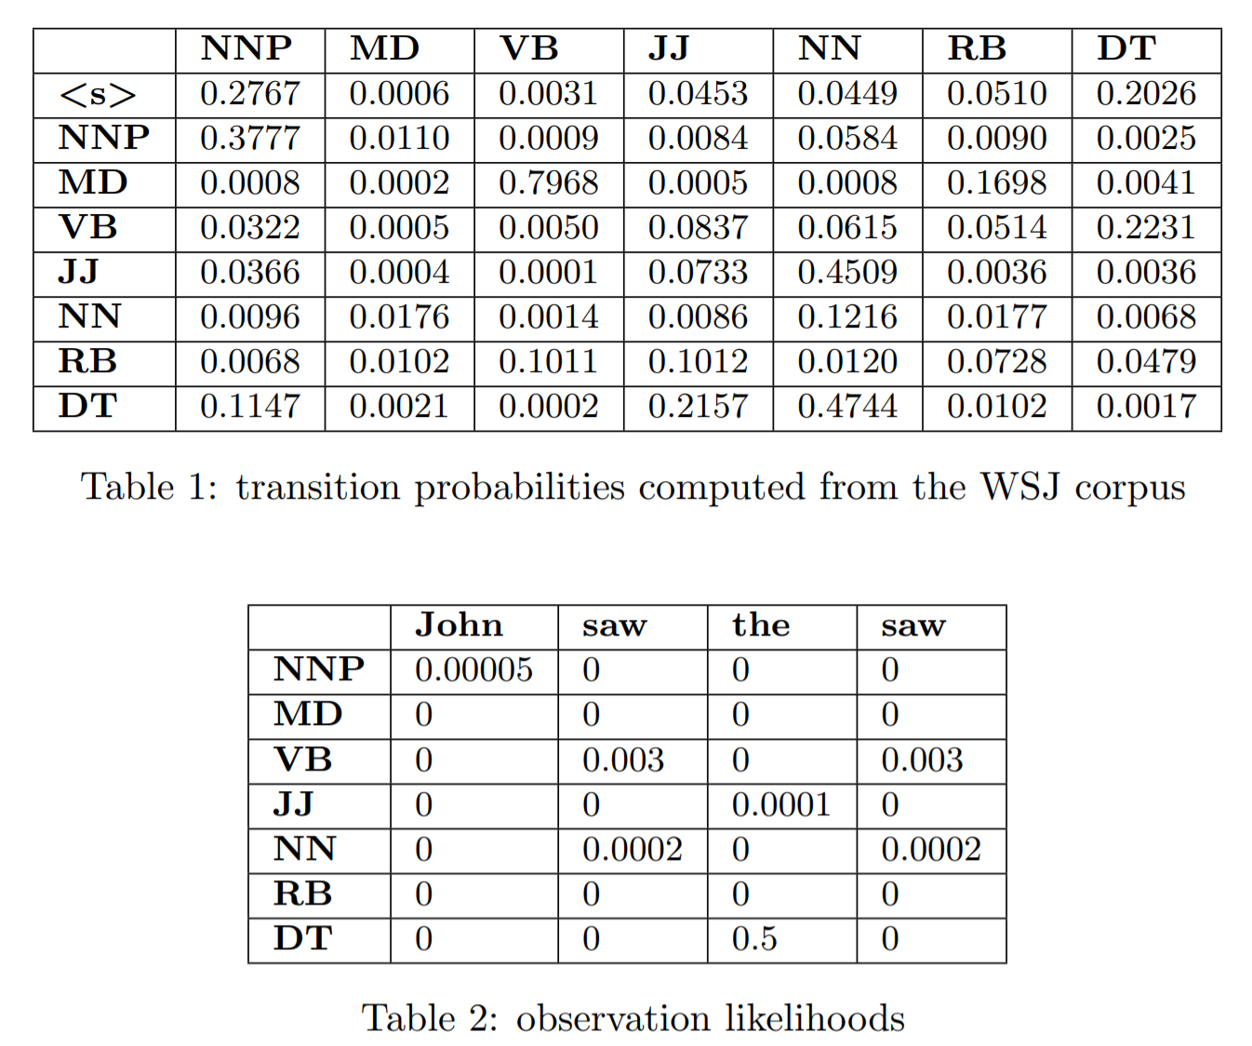
Quiz 2

Slide 3
Quiz 3
h1
W11=0.1
k11=0.4
0.3
i1
o1
W21=0.2
k21=0.3
k12=0.7
i2
W12=0.9
o2
0.7
h2
k22=0.5
W22=0.8
b1
b2
0.1
0.2

Slide 4
Assignment 3
Instructions are on canvas
Download the scripts and data from canvas
Due Mar 5 at 2pm

Slide 5
Intro: Scripts and Data
cfggen.pl randomly generate samples from a PCFG
cfgparse.pl parses sentences using a PCFG by finding the most probable parse
grammar1 , grammar2 , and lexicon give you the starting point for building a PCFG for a subset of English
Examples.sen gives you some sentences in that subset of English

Slide 6
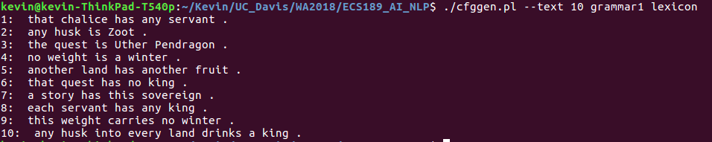
Intro: Scripts and Data
./cfggen.pl --text <N> grammar1 lexicon

Slide 7
Intro: Scripts and Data
./cfgparse.pl grammar1 lexicon < examples.sen

Slide 8
Task 1
Look at the file grammar2
gramma2
ROOT -> S2 1 S2 -> 1 S2 -> +Det 1 S2 -> +Misc 1 S2 -> +Noun 1 S2 -> +Prep 1 S2 -> +Proper 1 S2 -> +VerbT 1 +Det -> Det 1 +Det -> Det +Det 1 +Det -> Det +Misc 1 +Det -> Det +Noun 1 +Det -> Det +Prep 1 +Det -> Det +Proper 1 +Det -> Det +VerbT 1
Lexicon
Noun -> castle 1
Noun -> king 1
Noun -> defeater 1
Noun -> sovereign 1
Noun -> servant 1
Noun -> corner 1
Noun -> land 1
Noun -> quest 1
Noun -> chalice 1
Notes:
Get the performance using the scripts we provide

Slide 9
Task 1
Run:
./cfgparse.pl grammar2 lexicon < examples.sen
What kind of model does this PCFG implement? Give your thoughts.

Slide 10
Task 2
Look at the file grammar1
gramma1
ROOT -> S1 99
S1 -> NP VP . 1
VP -> VerbT NP 1
NP -> Det Nbar 20

Slide 11
Task 2
Compare the outcome when you run:
./cfgparse.pl grammar1 lexicon < examples.sen
./cfgparse.pl grammar1 grammar2 lexicon < examples.sen
Explain what's going on

Slide 12
Task 3
Compare the outcome when you run:
./cfggen.pl --text <N> grammar1 lexicon
./cfggen.pl --text <N> grammar2 lexicon
./cfggen.pl --text <N> grammar1 grammar2 lexicon
Explain what's going on

Slide 13
Task 4
Design your own Grammar:
gramma1
ROOT -> S1 99
S1 -> NP VP . 1
VP -> VerbT NP 1
NP -> Det Nbar 20
my gramma
ROOT -> S1 99
S1 -> NP VP . 8
S1 -> VP 1
S1 -> X1 VP 1
X1 -> AUX NP 1
VP -> VP PP 20
VP -> VerbT NP 80
NP -> Det Nbar 20

Slide 14
Task 4
Design your own Lexicon:
Lexicon
VerbT -> carries 1
VerbT -> rides 1
Misc -> ! 1
Misc -> . 1
Misc -> ? 1
Misc -> , 1
Misc -> and 1
Misc -> but 1
Misc -> or 1
Misc -> either 1
My Lexicon
VerbT -> carries 1
VerbT -> rides 1
Punc -> ! 1
Punc -> . 10
Punc -> ? 3
Punc -> , 10
CC -> and 10
CC -> but 2
CC -> or 1
CC -> either 1

Slide 15
Task 4
Constraints:
1. You can only generate binary or unary rule in grammar and lexicon file.
2. Cannot include new words in lexicon as terminals.
A -> B C
A -> B
A -> B C D

Slide 16
Task 4
Goals:
1. The PCFG will predict high probability for a grammatical English sentence and predict low probability for an ungrammatical sentence.
./cfgparse.pl mygrammar mylexicon < examples.sen
2. The PCFG will never fail to parse a string of words.
3. The PCFG will be able to generate grammatical sentences.

Slide 17
Task 4
Competitive Task
1. Minimum Requirement: (1) Beat the performance of a merged gramma from gramma1 and gramma2 with the default lexicon. (2) Never fail to parse any sentence in the test dataset.
Meet this requirement to get full points for this task.
2. Compete against you classmates: Top 10% get 5 extra points for this assignment.

Slide 18

Task 4
Evaluation Metrics
Collect grammatical sentences generated from each of your grammar to form a test dataset.
Compute the cross-entropy to evaluate how well can your gramma predict the sentences in the test dataset.
P(s) – The probability of the string s is the sum of the probabilities of the trees which have that string as their yield
The lower value is better.

Slide 19
Task 5
Evaluation Metrics
Generate 20 sentences with your grammar and lexicon and keep it in a file
Remove all the ungrammatical sentences from the 20 sentences and keep it in another file.
What is the fraction of grammatical sentences generated

